Slide 1


延迟符号
Abura Technik GmbH
Suzhou Kunyao
2023.10

Slide 2


1
公司简介
COMPANY INTRODUCTION
COMPANY
PROFILE
公司介绍
延迟符号
Abura Technik GmbH 成立之初主要为中国的兄弟公司苏州坤尧机电科技有限公司提供采购服务。随着越来越多的中国企业到欧洲投资建厂，我们也开始提供工程安装，设备改造设计及人力资源等服务。
Abura Technik GmbH was initially founded to provide procurement services for our sister company in China, Suzhou Kunyao Mechatronics Technology Co. Ltd. As more and more Chinese companies invested in Europe, we also started to provide services such as engineering and installation, retrofit design and human resources.

Slide 3
1
发展历程
COMPANY HISTORY
2015.04
2013.09
2015.10
2023
拿到了第一个超过100万的订单 ！
First single sales contract >2 million RMB
坤尧美国采购办公室从宾夕法尼亚搬迁到波士顿
U.S. purchasing office moved to Boston
筹建匈牙利分公司 Preparing for the establishment of the Hungarian branch
坤尧在中国苏州成立
Kunyao was established in Suzhou, China
在美国宾夕法尼亚设立采购办事处
U.S. purchasing office established
2019.06
延迟符号
坤尧签订了第一单合同
Received the first sales contract
在荷兰注册欧洲分公司
Registration of a European branch in the Netherlands
在德国杜伊斯堡注册Abura Technik GmbH
Registration of Abura Technik GmbH in Duisburg, Germany
目前我们与全球993家生产商合作
We currently work with 993 manufacturers worldwide
2013.10
2019.02
2015.07
2022.11

Slide 4
1
发展历程
COMPANY HISTORY
2023.09
迁往德国阿恩施塔特 Abura Technik moves to new office & warehouse in Arnstadt, Germany
延迟符号

Slide 5
1
发展历程
COMPANY HISTORY
20154
延迟符号

Slide 6
2
组织架构
ORGANIZATIONAL STRUCTURE
GM
Abura You
US Office
Suzhou Kunyao Mechanical
and Electrical Technology Co., Ltd.
Abura Technik GmbH
Manager
Jinhu Wang
Project Manager
Jason Wu
Vice GM
Erik Levin
Technical Manager
Recruiting
Assisstant of GM
Ju Xu
Sales Manager
XianFeng You
Purchasing Manager
Ju Xu
Assistant
Hokin
Cashier
Fangfang Bian
Warehouse/Logistic
Zhiying Gu
Guangjian Huang
Sales Engineer
Recruiting
Sourcing Engineer
Zhang Min

Slide 7
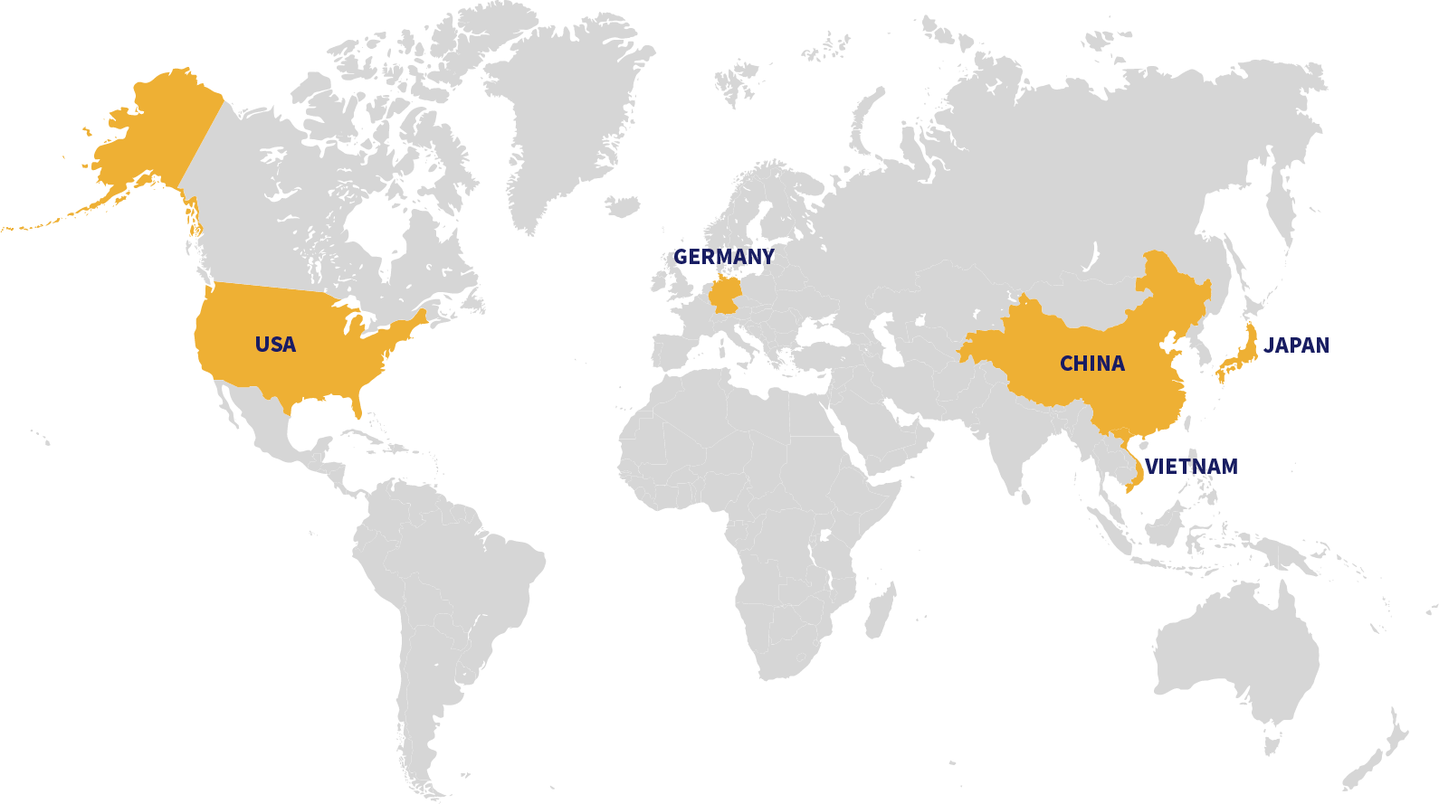
3
业务分布
OFFICE LOCATIONS
Abura Technik GmbH, Arnstadt
Purchasing Office, NY
延迟符号
Boston, Office
Suzhou Kunyao M&E Tech. Co., Ltd
添加标题
在此录入上述图表的综合描述说明。

Slide 8
3
业务介绍
BUSINESS FIELDS
协助客户在欧洲和北美建立销售/采购据点
Support Customers in setting up purchasing/sales centers in Europe/North America
采购服务
Purchasing Service
系统设计与集成
System Design and Assembly
库存物料回购/协助处理
Inventory material repurchase/ assistance in disposal
50%
40%
5%
5%

Slide 9
3
业务介绍
BUSINESS FIELDS
为客户从国外进口设备及各类零部件
Importing equipment and various parts from abroad for customers
寻源并组织品牌技术人员与客户做技术交流
Sourcing and organize brand technicians to do technical communication with customers
延迟符号
采购服务
Purchasing Service
推荐其他资源为客户降本项目提供支持
Recommend other resources to support cost reduction projects for clients
帮助客户解决紧急需求
Help customers with urgent needs
支持客户优化供应链，例如供应商库存管理、精益生产……
Support customers to optimize their supply chain, e.g. supplier inventory management, lean manufacturing ......

Slide 10
3
业务介绍
BUSINESS FIELDS
液压油独立循环冷却过滤系统
Independent circulation and filtration system for hydraulic oil
主驱动齿轮油润滑系统
Main drive gear oil lubrication system
系统设计与集成
System Design
and Assembly
延迟符号
循环水冷却过滤系统
Circulating water cooling and filtration system
隧洞环境制冷系统
Tunnel environmental cooling system

Slide 11
3
业务介绍
BUSINESS FIELDS
丰富的流程自动化经验
Rich experience in process automation
与宁德时代集团,大陆集团，纬湃科技及其他客户的稳定合作
Stable cooperation with CATL , Continental, Vitesco and other customers
过程自动化
Process Automation
延迟符号
技术服务、生产线改造、售后维护、产品采购和其他服务
Technical services, production line modification, after-sales maintenance, product procurement and other services
生产线改造
Production line modification
售后维护、产品采购和其他服务
After-sales maintenance, product procurement and other services

Slide 12
3
业务介绍
BUSINESS FIELDS
2022
Timisoara，
RO
Continental HUD assembly line installation
2022-2023
Magdeburg,
DE
MEB module packing line installation and debugging
2020-2023
Trutnov，
CZ
Continental CFCV assembly line
过程自动化
Industry Automation
延迟符号

Slide 13

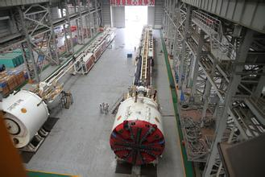
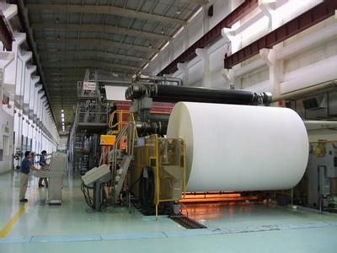


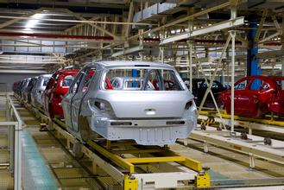
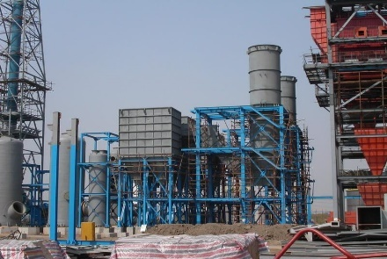
3
服务行业
INDUSTRY SERVICE
RESEARCH BACKGROUNDS
矿山和工程机械
Mining & Engineering
制浆造纸
Paper and Pulp
化工
Chemical
航空
Aviation & Aerospace
汽车
Automobile
冶金
Metallurgy

Slide 14
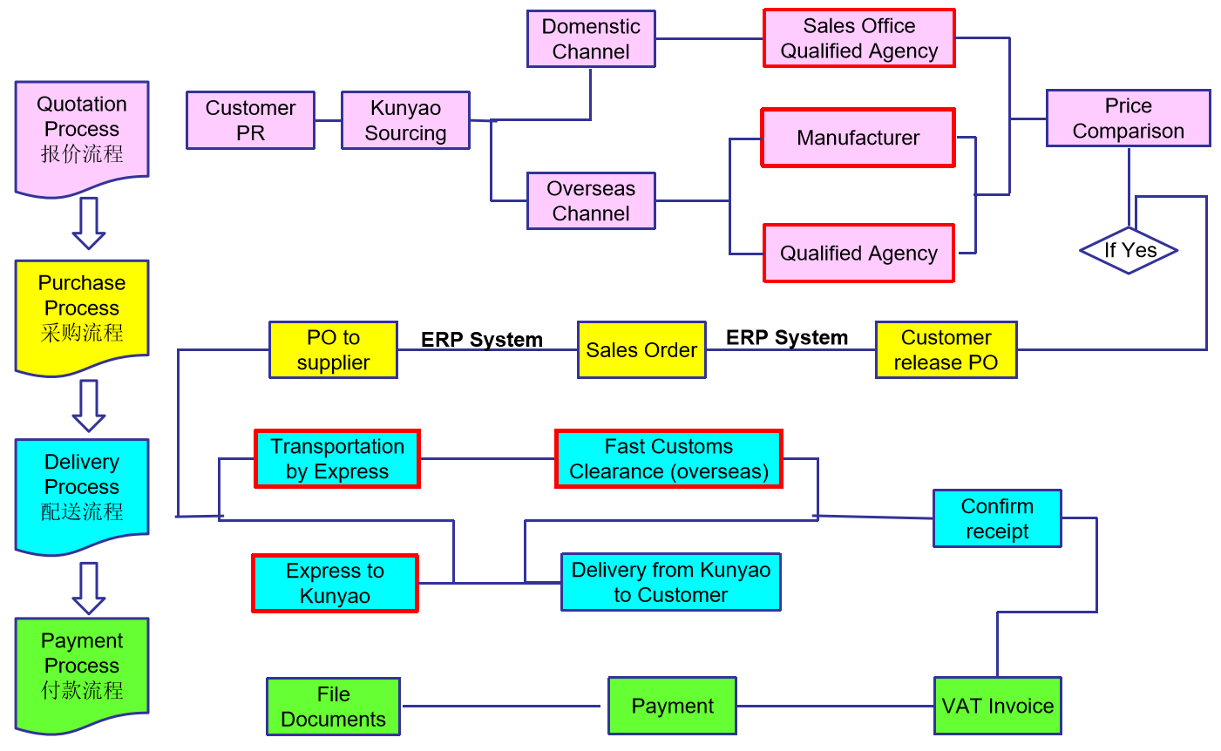
3
服务流程
WORK FLOW

Slide 15
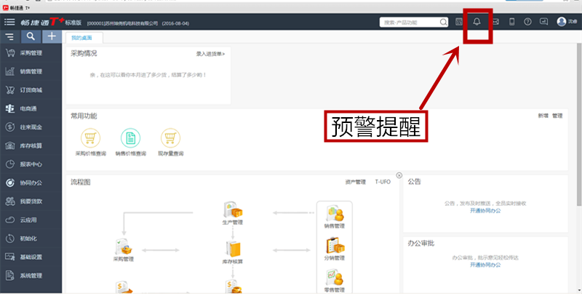
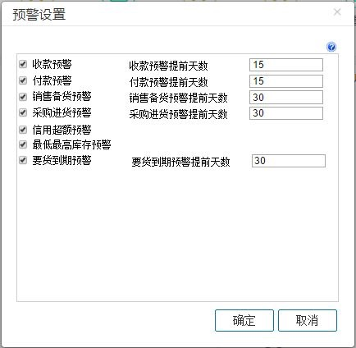
3
服务流程
WORK FLOW
为了提供工作效率，引进用友畅捷通系统管理软件，自动预警提醒与供应商定期
确认货期
Warning function in ERP system supporting timely delivery

Slide 16

4
客户案例
KEY CUSTOMERS
维美德（中国）有限公司（上海工厂、西安工厂和无锡工厂）
Valmet ( China) Co., Ltd.（Shanghai factory, Xi’an Factory and Wuxi Factory）
供应过230多个品牌上万个型号的产品，主要是欧洲品牌，尤其是芬兰和德国品牌。如Haacon、EKD、AVS、Blickle、Lapp、Toppi、Halder、Strohm、DG、Stauff…
We have supplied more than 230 brands and tens of thousands of models, mainly European brands, especially Finnish and German brands. Such as Haacon、EKD、AVS、Blickle、Lapp、Toppi、Halder、Strohm、DG、Stauff…
Valmet是全球领先的纸浆、造纸和能源行业技术、自动化和服务开发商和供应商。在世界各地的13000多名专业人员与客户密切合作，并致力于每天提高客户的绩效。2019年，Valmet的净销售额约为35亿欧元。
Valmet is the leading global developer and supplier of technologies, automation and services for the pulp, paper and energy industries. More than 13,000 professionals around the world work close to customers and are committed to moving our customers’ performance forward – every day. Valmet’s net sales in 2019 were approximately EUR 3.5 billion.
www.valmet.com

Slide 17

4
客户案例
KEY CUSTOMERS
中交天和机械设备制造有限公司
CCCCTH Tianhe Mechanical Equipment Manufacturing Co.,Ltd.
供应过184个品牌，主要是德国和美国品牌。如MHA、MTS、Hydac、E+H、Stauff、IST、Voith、Kracht、Lincoln…
Supplied 184 brands, mainly German and American brands. Such as MHA、MTS、Hydac、E+H、Stauff、IST、Voith、Kracht、Lincoln…
中交天和主要从事TBM和海船的设计和制造，并提供集成施工和管理通信基础设施的服务，涵盖道路工程、土木工程、轨道交通工程。中国第三大隧道掘进机制造商。
CCCCTH is principally engaged in the design and manufacturing of TBMs and marine ships and provides service integrating construction and management communication infrastructure, covering road works, civil works, rail transportation works. The third biggest tunneling machine manufacturer in China.
www.ccccth.com

Slide 18

4
客户案例
KEY CUSTOMERS
会田锻压机床有限公司
AIDA PRESS MACHINERY SYSTEMS CO., LTD. (Nantong)
供应过80多个品牌，主要来自欧洲，尤其是意大利。如Gefran、Ross、Voss、Philip、Weidmueller、Bussmann、Parker、Schnorr、Hydac、Oleotec…
We have supplied more than 80 brands, mainly from Europe, especially Italy. Such as Gefran, Ross, Voss, Philip,
Weidmueller, Bussmann, Parker, Schnorr, Hydac, Oleotec…
AIDA ENGINEERING最初由Yokei AIDA在东京创立，名为AIDA Ironworks。在过去的100年中，他们专注于印刷机的开发、制造和销售，并已发展成为一家全球性公司，在日本、亚洲、美国和欧洲拥有生产和开发设施。“艾达”是印刷行业的全球品牌，他们的设备被许多客户广泛使用。
AIDA ENGINEERING was originally founded as Aida Ironworks in Tokyo by Yokei Aida. Over the 100 years, They have concentrated on the development, manufacture, and sale of presses, and have grown into a global company with production and development facilities in Japan, Asia, the United States, and Europe.“AIDA” is a global brand in the press industry, and their equipment is widely used by many customers.
www.aida.co.jp

Slide 19

4
客户案例
KEY CUSTOMERS
空中客车天津总装有限公司
Airbus (Tianjin) Final Assembly Co. Ltd.
供应过60多个品牌，主要是欧洲品牌，尤其是法国品牌。如Aerem、ADF（ETT）、Hycom、Hydro、Rifa、Ibertecnic、Langa、Aritex…
Supplied more than 60 brands, mainly European brands, especially French brands. Such as Aerem, ADF(ETT), Hycom, Hydro, Rifa,
Ibertecnic, Langa, Aritex…
空客是航空航天行业的国际先驱。他们在设计、制造和向全球客户提供航空航天产品、服务和解决方案方面处于领先地位。我们的目标是建立一个联系更好、更安全和更繁荣的世界。
Airbus is an international pioneer in the aerospace industry. They are a leader in designing, manufacturing and delivering aerospace products, services and solutions to customers on a global scale. We aim for a better-connected, safer and more prosperous world.
www.airbus.com

Slide 20


4
新客户
NEW CUSTOMERS
帝目自动设备（苏州）有限公司
Teamtechnik Production Technology(Suzhou) Ltd.
帝目集团是装配和功能测试系统生产科技的国际市场领导者。总部位于德国弗莱贝格，一直专注于为汽车电动化、医疗技术和新能源领域开发和构建定制自动化系统。is an international market leader in assembly and functional test system production technology. Headquartered in Freiberg, Germany. It has been focusing on the development and construction of customized automation systems for automotive electrification, medical technology and new energy fields.
提供主要是欧洲品牌。如Hydac、Banner…
Provide mainly European brands. Such as Hydac, Banner....
震坤行工业超市（上海）有限公司
Zhenkunxing Industry Supermarket (Shanghai) Co.,Ltd.
一家数字化的工业用品服务平台，致力于工业用品供应链的数字化建设，助力企业采购管理数字化升级，为客户提供一站式的工业用品采购与管理服务。A digital industrial supplies service platform is committed to the digital construction of the industrial supplies supply chain, helping the digital upgrading of enterprise procurement management, and providing customers with one-stop industrial supplies procurement and management services.
提供主要是欧洲品牌。如Hydac、BoschRexroth、Parker、KLUBER、E+H、CAMOZZI、Banner…
Provide mainly European brands. Such as Hydac, BoschRexroth、Parker、KLUBER、E+H、CAMOZZI、Banner…

Slide 21


4
新客户
NEW CUSTOMERS
江苏烽禾升智能科技有限公司
Jiangsu Fenghesheng Intelligent Technology Co., Ltd.
烽禾升(FHS)集团成立于1990年，总部位于江苏省昆山市，在中国拥有三大制造基地，遍布全球的售后服务网络和专业化的技术团队为全球医疗100强、汽车零部件100强、全球知名新能源电池、电机、主机厂等客户提供全球一流的智能化、数字化、柔性化智能制造生产解决方案及数据服务。FHS Group was established in 1990 and headquartered in Kunshan, Jiangsu. FHS owns three wholly-owned subsidiaries, serves numerous world-famous enterprises. Relies on various automation solutions and optical inspection automation solutions, we provide reliable and efficient automatic production lines and solutions for many customers among the world’s top 100 auto parts corporations, top 100 medical and health care corporations, leading OLED, semiconductor corporations, domestic and foreign lithium battery and motor manufacturers.
提供主要是欧洲品牌。 Provide mainly European brands.
上海固买供应链管理有限公司
Shanghai Gumai Supply Chain Management Co., Ltd.
是一家高新技术软件公司。并致力于与用户合作打造的企业专属高效的工作台。固买信息技术以云平台为核心，用低代码赋能企业上下游， 为企业提供数字化整体解决方案。It is a high-tech software company. And we are committed to working with users to create an enterprise specific and efficient workbench. With the cloud platform as the core, Gumai Information Technology empowers enterprises upstream and downstream with low code to provide enterprises with overall digital solutions.
提供所有欧洲品牌。Provide all of European brands.

Slide 22


























4
产品展示
FEATURED SUPPLIERS

Slide 23























4
产品展示
FEATURED SUPPLIERS
延迟符号

Slide 24





















4
产品展示
FEATURED SUPPLIERS
延迟符号

Slide 25










4
产品展示
FEATURED SUPPLIERS
延迟符号

Slide 26
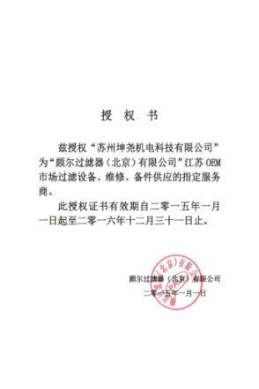
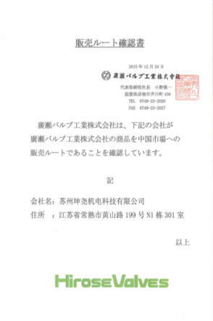
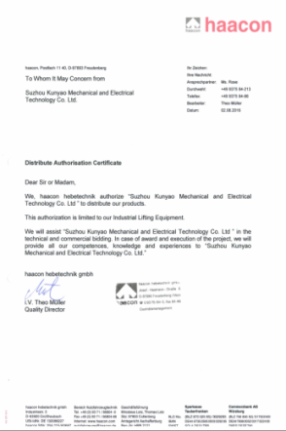
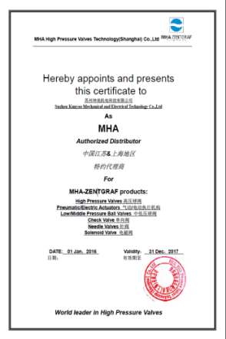
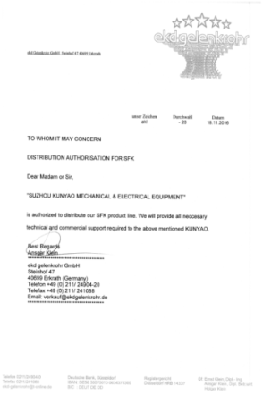
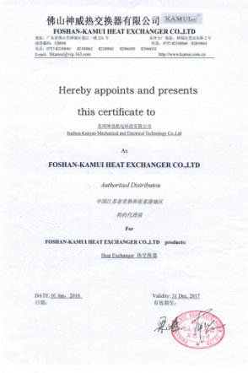
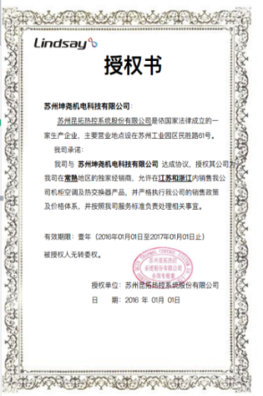

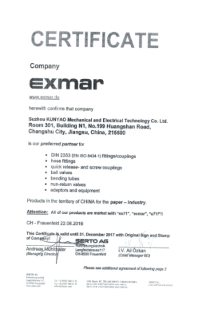
4
授权证书
CERTIFICATIONS
瑞士Exmar不锈钢接头代理证书
日本广濑Hirose液压阀代理证书
日本神威KAMUI换热器代理证书
日本EKK蓄能器代理证书
美国MTS位移传感器代理证书
德国MHA高压球阀代理证书
德国Haacon代理证书
德国EKD电缆防护代理证书
德国Hydac代理证书
德国E+H仪表代理证书
德国Blickle脚轮授权证书

Slide 27
5
联系方式
RESEARCH BCKGROUNDS
CONTACT INFORMATION
CH
中国总部 China Headquarters
Name：油现锋 Xianfeng You
Tel.：+86 18915617883
Mail：xf.you@szkunyao.com
Address：江苏省常熟市黄河路12号常熟国际贸易中心B905，邮编215500
联系我们
Contact Us
美国办公室 US Office
US
Name：Jinhu Wang
Tel.：+1 857 498 9508
Mail：info@szkunyao.com
Address：Room 207, 330 Pleasant Street, Watertown MA 02472-3745
德国公司 Abura Technik GmbH
DE
Name：Erik Levin
Tel.： +49 (0) 162 496 7474
Mail: info@abura-technik.de
Address: Ichtershäuser Str. 74d, 99310 Arnstadt

Slide 28
6
逸飞专项
RESEARCH BCKGROUNDS
Only for Yi Fi
1
海外公司办理
2
签证
四大问题
3
发货
4
CE 认证

Slide 29
6.1
公司办理
公司选址
当地公证人以及认证翻译机构
公司办理流程
延迟符号
商业银行开户以及注册资金准备
审核
完成注册

Slide 30
6.2
签证办理
德国工签1---当地公司签合同，办理签证
德国工签2---中国公司外派，办理1-3年的签证
签证办理
延迟符号
德国商务签
其他申根国商务签
旅游签

Slide 31
6.3
CE认证
国内认证流程---认证供应商选择建议征求客户意见
认证资料需要完整保存--- F公司例子
CE认证
延迟符号
认证结果需要在发货前与客户充分评审--- C公司例子
Re-Audit的操作流程--- S公司，Conti例子
现场变更处理

Slide 32
6.4
发货
物流公司选择
打包方式选择（防疫要求）
发货
延迟符号
报关问题处理（物料品类，特别是备件物料）
送货计划合理安排

Slide 33
延迟符号
演示完毕 感谢聆听
Thank you for your attention！
2023

